Slide 1
Lists, Document Libraries and Content Types
Defining your persistent data structures

Slide 2
Agenda
Content storage enhancements in WSS 3.0
WSS storage fundamentals
Site columns
Content types
Provisioning lists and document libraries

Slide 3
Motivation: Content Storage in WSS
All storage in WSS based on concept of the list
Everything is modeled in terms of rows and columns
Document library is really just a hybrid list
WSS adds value on top of generic list concept
Transparent content storage in SQL Server
Automatic generation of user interface

Slide 4
Platform Storage Enhancements
Parity between lists and document libraries
Folders supported for lists as well as document libraries
Versioning supported for list items as well as document
Events supported on lists as well as document libraries
List and Document Library Enhancements
Recycle bin
Required check-out
Enhanced versioning
New productivity-oriented built-in field types
Wide list support allowing 100s of columns (e.g. surveys)
Custom column indexing to improve performance

Slide 5
Issues with Managing Content
Problems with managing content in large companies
Many document types identified in an organization, but there is no clear way to enforce standards
There's a need to create different types of documents and store them all in one central location
Content management application should make list of actions available to users depend on the type of content or document
WSS provides new features to solve these problems
Site Columns
Content Types

Slide 6
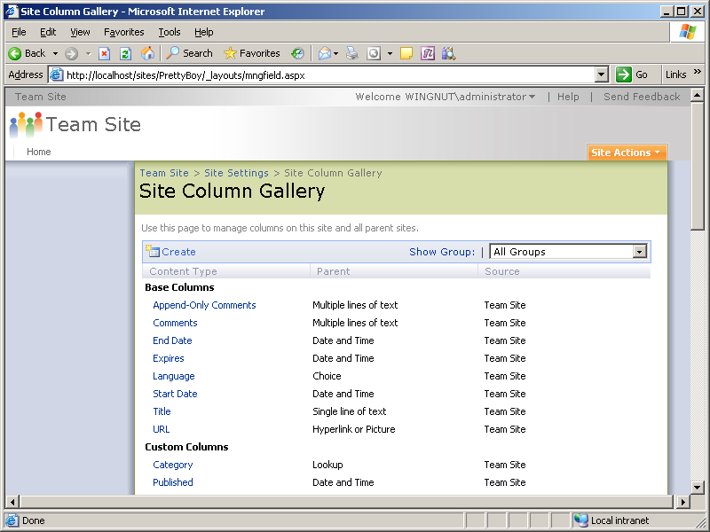
Site Columns
Site column is a reusable column definitions
Site column can be reused across multiple lists
Site column scoped to site in Site Column Gallery
Site column visible within site collection to all child sites

Slide 7
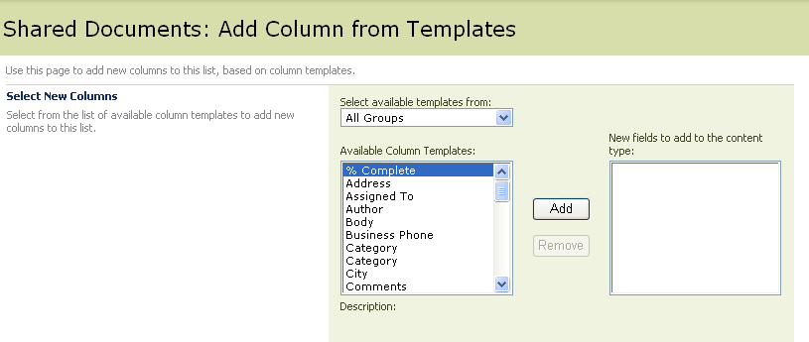
Using a Site Column in a List
Site Columns can be used in List Definitions
Site column represents a reusable, named column definition
Site column used in lists, document library or content types
Updates to a site column can optionally be pushed out to lists, document libraries and content types where it has been used

Slide 8
Creating Site Columns
DEMO

Slide 9
Introduction to Content Types
Foundation for content management in WSS v3
Reusable definition for list schema
Defines constraints and requirements for an item type
Created by users and developers
Reused and extended by users

Slide 10
Examples for Content Types
Proposals for software projects
Requires client assignment
Requires review by legal department
Customer presentation
Requires client assignment
Requires review by art department

Slide 11
Content Types
A content type definition can include…
Columns to represent metadata or properties
A document template for creating new documents
Custom forms for new, edit, display (dev only)
Event handlers (dev only)
Workflows (dev only)

Slide 12
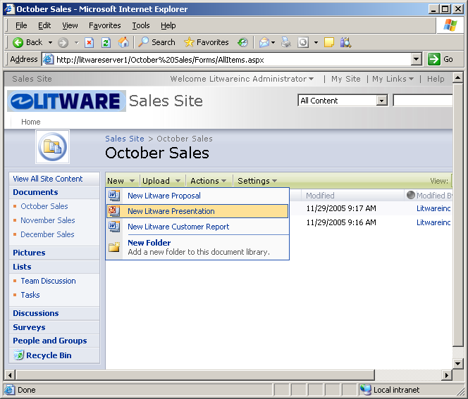
Supporting Multiple Content Types
Lists can support multiple content types
Makes it possible to support heterogeneous content
“New button” becomes a dropdown list
Input and display forms change depending on content type

Slide 13
Inheriting Content Types
Allows base definition reuse across multiple types
Core properties can be defined in base content type
Base content type inherited by more specific content types
Base Document
Litware Document
Litware Proposal
Litware Presentation

Slide 14
Creating Content Types
DEMO

Slide 15
Summary
Content storage enhancements in WSS 3.0
WSS storage fundamentals
Site columns
Content types
Provisioning lists and document libraries

